Slide 1

CMR Technical Campus
Department of CSE
Major Project Stage -I
Project Title: Smart Crisis Management: A Unified System for Early Warning, Emergency Supply Allocation, and Post-Disaster Recovery Tracking
Project Supervisor:​
Name:​ V. Neeraja
Designation: Assistant Professor
Presented By:​
Batch No: 23
H. No: 227R1A05J8 Name: T. Vaishnavi
H. No: 227R1A05G7 Name: P. Vishali​
H. No: 237R5A0520 Name: K. Shiva Krishna ​

Slide 2
CONTENTS
Abstract
Problem Definition
Literature Review
Proposed System
Objectives
Methodology
System Architecture
Analysis
Screen Shots-Output
Results and Discussion
Conclusion and futurework
References

Slide 3
DEPARTMENT VISION AND MISSION
DEPARTMENT VISION:
To provide quality education and a conducive learning environment in computer engineering that foster critical thinking, creativity, and practical problem-solving skills.
DEPARTMENT MISSION:
1.To educate the students in fundamental principles of computing and induce the skills needed to solve practical problems.
2. To provide State-of-the-art computing laboratory facilities to promote industry institute interaction to enhance student’s practical knowledge.
3. To inculcate self-learning abilities team spirit, and professional ethics among the students to serve society.

Slide 4
ABSTRACT​
Disasters cause major threats to people, infrastructure, and economies, often worsened by slow communication and poor coordination.
This study presents a smart crisis management framework using IoT sensors, predictive analytics, and automation for real-time monitoring and quick decision-making.
It helps identify high-risk areas, allocate emergency resources efficiently, and coordinate agencies through a centralized dashboard.
Simulations and data analysis show faster responses, better resource use, and improved recovery tracking.
The integrated approach enhances disaster preparedness, minimizes losses, and supports data-driven decision-making.

Slide 5
LITERATURE REVIEW
Gupta, R. & Mehta, S. (2022) – IEEE AccessDeveloped an IoT-based Early Warning System integrating satellite and sensor data for disaster prediction.Enhanced alert accuracy and reduced false alarms using real-time environmental monitoring.
Iqbal, T. & Rahman, N. (2023) – Springer, Journal of Disaster Risk ManagementProposed a Machine Learning framework for optimizing emergency supply allocation during natural disasters.Applied Reinforcement Learning to improve decision-making speed and efficiency in relief distribution.
Patel, D. & Singh, P. (2023) – Elsevier, Expert Systems with ApplicationsImplemented a Smart Crisis Response Model combining GIS, AI, and blockchain for transparent resource tracking.Reported improved coordination among agencies and reduced duplication of aid efforts.
Chen, L. & Wang, Y. (2024) – IEEE Transactions on Computational IntelligenceIntroduced a Deep Neural Network with attention-based feature extraction for post-disaster damage assessment.

Slide 6
PROBLEM DEFINITION
• Disaster response is often delayed due to slow alerts and manual reporting systems.
• Emergency resources are not distributed efficiently because of poor planning and lack of real-time data.
• Communication between agencies is fragmented, leading to coordination problems during crises.
• Post-disaster recovery is not properly monitored, making rehabilitation slow and unorganized.
• There is no unified platform that integrates early warning, resource allocation, and recovery tracking.

Slide 7
OBJECTIVES
Develop a Unified Crisis Management System – Integrate early warning, emergency supply allocation, and post-disaster recovery tracking.
Enhance Response Efficiency – Reduce delays in disaster alerts and resource deployment.
Improve Accuracy of Disaster Predictions – Use predictive analytics and IoT data for timely detection.
Ensure Scalability and Real-Time Processing – Handle large-scale disasters efficiently.
Strengthen Community Resilience – Minimize human and economic losses through proactive disaster management.

Slide 8
PROPOSED SYSTEM
• Provides an end-to-end disaster management platform integrating early warning, response, and recovery.
• Uses predictive analytics and real-time data to detect disaster risks and forecast impact.
• Automates emergency resource allocation to ensure efficient and timely supply distribution.
• Monitors post-disaster recovery and offers a centralized dashboard for coordinated decision-making.
• Scalable and robust system capable of handling large datasets and multiple disaster situations simultaneously.

Slide 9
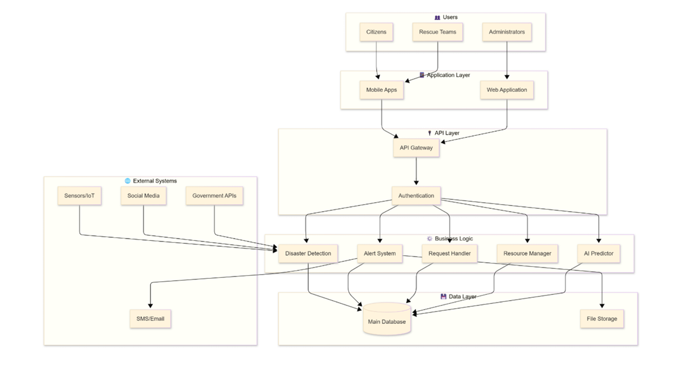
SYSTEM ARCHITECTURE

Slide 10
Implementation (Sample Code)
import Array "mo:core/Array";
import Iter "mo:core/Iter";
import Map "mo:core/Map"; import Set "mo:core/Set"; import Text "mo:core/Text";
import Nat "mo:core/Nat"; import Int "mo:core/Int"; import Time "mo:core/Time";
import Order "mo:core/Order";
import Runtime "mo:core/Runtime";
import Principal "mo:core/Principal";
import AccessControl "authorization/access-control"; import Storage "blob-storage/Storage

Slide 11
actor { // --------------------------
// Type Definitions & Compare Modules
// -------------------------- type UserId = Principal; type IncidentId = Nat; type AlertId = Nat; type TaskId = Nat; public type Severity = { #low; #medium; #high; #critical }; public type UserRole = { #admin; #volunteer; #citizen; }; public type Location = { latitude : Float; longitude : Float; region : Text; }; public type UserProfile = { id : UserId; name : Text; role : UserRole; location : Location; contactInfo : Text; };

Slide 12
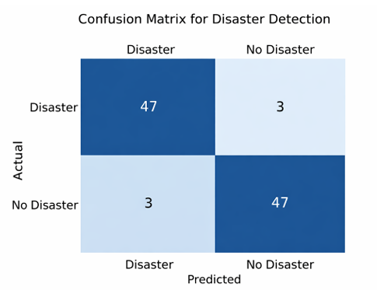
RESULT AND DISCUSSION
n
Fig 6: Confusion Matrix for Disaster Detection

Slide 13
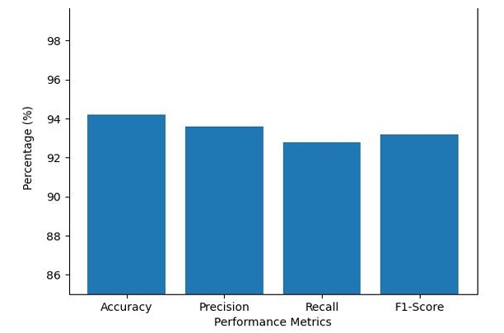
Fig 5 :Performance Metrics of Smart Crisis Management System

Slide 14
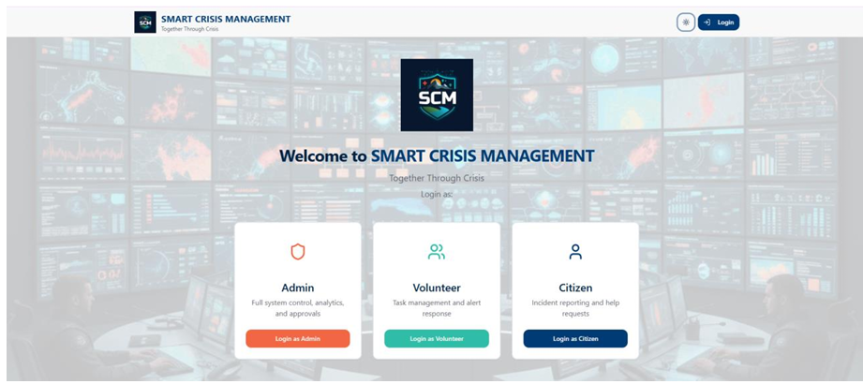
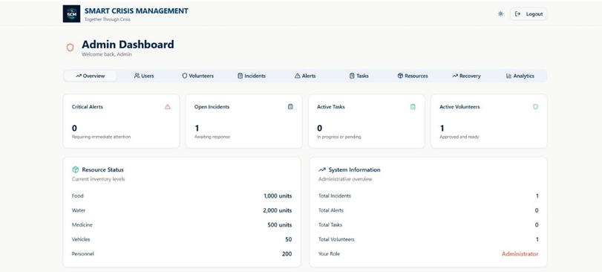
SCREENSHOTS OUTPUT
Fig 1: GUI/Main Interface of Smart Crisis Management System
Fig 2: Admin Dashboard of Smart Crisis Management System

Slide 15
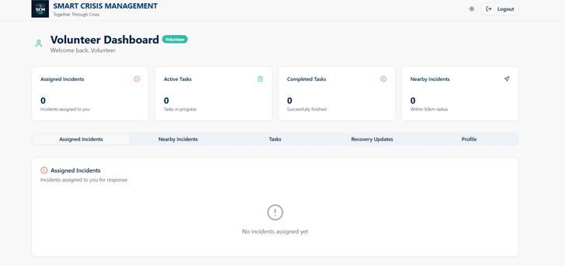
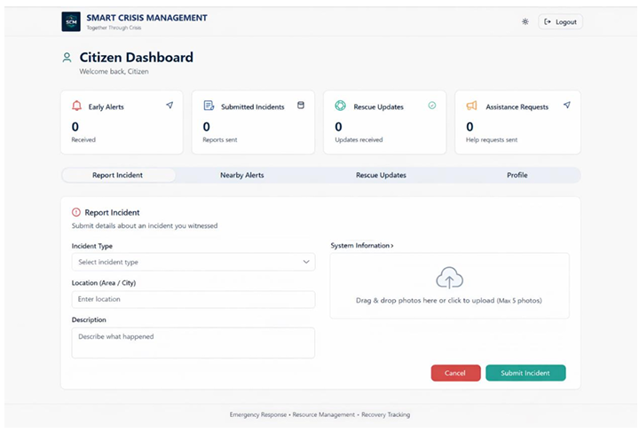
Fig 3: Volunteer Dashboard of Smart Crisis Management System Fig 4: Citizen Dashboard of Smart Crisis Management System

Slide 16
Tools and Technologies
Operating System : Windows 10+ or Android 13+
Language : Python, JavaScript (React Native), Node.js
Front-End : React Native / React.js
Back-End : Node.js with Express
Database : Firebase Firestore

Slide 17
CONCLUSION AND FUTUREWORK
Developed a unified platform for early warning, incident reporting, resource allocation, and recovery tracking.
Enabled real-time citizen reporting and faster authority response.
Improved coordination, situational awareness, and structured disaster management.
Secure role-based access for administrators, volunteers, and citizens.
Future Work
AI & ML Integration → Better disaster prediction and risk analysis.
IoT Sensors → Real-time monitoring of water levels, temperature, seismic activity.
GIS & Satellite Imagery → Enhanced visualization and planning of relief operations.
Continuous improvement for scalability, sustainability, and innovation.

Slide 18
REFERENCES
[1] S. Marzi, J. Mysiak, A. H. Essenfelder, J. S. Pal, L. Vernaccini, M. N. Mistry, L. Alfieri, K. Poljansek, M. Marin-Ferrer, and M. Vousdoukas, “Assessing future vulnerability and risk of humanitarian crises using climate change and population projections within the INFORM framework,” Global Environmental Change, vol. 71, p. 102393, 2021.
[2] W. Sun, P. Bocchini, and B. D. Davison, “Applications of artificial intelligence for disaster management,” Natural Hazards, vol. 103, no. 3, pp. 2631–2689, 2020.
[3] B. Adini, O. Cohen, A. W. Eide, S. Nilsson, L. Aharonson-Daniel, and I. A. Herrera, “Striving to be resilient: What concepts, approaches and practices should be incorporated in resilience management guidelines?” Technological Forecasting and Social Change, vol. 121, pp. 39–49, 2017.
[4] P. P. Ray, M. Mukherjee, and L. Shu, “Internet of Things for disaster management: State-ofthe-art and prospects,” IEEE Access, vol. 5, pp. 18818–18835, 2017.
[5] M. Aboualola, K. Abualsaud, T. Khattab, N. Zorba, and H. S. Hassanein, “Edge technologies for disaster management: A survey of social media and artificial intelligence integration,” IEEE Access, vol. 11, pp. 1–18, 2023.
[6] K. Albris, K. C. Lauta, and E. Raju, “Strengthening governance for disaster prevention: The enhancing risk management capabilities guidelines,” International Journal of Disaster Risk Reduction, vol. 47, p. 101647, 2020.

Slide 19
THANK YOU

